Slide 1

Java Programming Essentials: A Comprehensive Journey into Core Java and Beyond
- Bharath Ashok

Slide 2

Day 9

Slide 3
Day 9: Agenda
Arrays
Strings
Interview Questions
Hands-on
Assignments

Slide 4
Arrays and Strings

Slide 5
Introduction to Arrays
Definition of Arrays
Advantages and use cases of Arrays
Array declaration and initialization

Slide 6
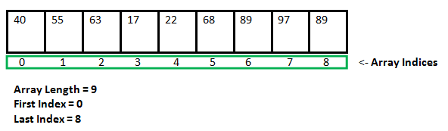
Arrays
An array is a data structure in programming that stores a collection of elements, all of the same type, arranged in a contiguous block of memory.
Each element in the array is accessed by its index or position within the array.
Arrays provide a convenient way to manage and manipulate multiple values of the same type as a single entity.
Advantages of using arrays include:
Efficient Data Storage: Arrays allocate memory in a contiguous manner, making them memory-efficient for storing a large number of elements.
Fast Access: Elements in an array can be accessed using their index, which provides O(1) constant-time complexity for access.
Sequential Processing: Arrays are suitable for operations that involve sequential processing of elements, such as iteration and searching.
Predictable Memory Layout: The memory layout of an array is predictable, making it easier to work with and optimize.
Simplicity: Arrays are a fundamental and simple data structure, making them easy to understand and use.

Slide 7
Array Declaration and Initialization
Declaration: Declare an array variable with a specific type and array name. The square brackets [] denote that the variable is an array.
Initialization: Allocate memory and assign values to the array.
There are several ways to initialize an array:
Using the new Operator: Allocate memory and specify the size of the array.
int[] numbers = new int[5];
Initializing with Values: Declare and initialize an array with specific values.
int[] numbers = {10, 20, 30, 40, 50};
Initializing After Declaration: Declare an array and then initialize it later.
int[] numbers;
numbers = new int[]{10, 20, 30, 40, 50};
Multi-dimensional Arrays: Declare and initialize multi-dimensional arrays.
int[][] matrix = {{1, 2, 3}, {4, 5, 6}, {7, 8, 9}};
Arrays of Objects: Declare and initialize arrays of objects.
String[] names == {"Alice", "Bob", "Charlie"};

Slide 8
Accessing Array Elements
Array indexing in Java
Looping through Arrays (for loop)
Common Array operations (finding sum, average, max, min)

Slide 9
Array Indexing in Java
In Java, arrays are zero-indexed, which means the first element of an array is accessed using index 0, the second element with index 1, and so on. Array indexing is done using square brackets [].
Example:
int[] numbers = {10, 20, 30, 40, 50};
int firstElement = numbers[0]; // Accessing the first element (10)
int thirdElement = numbers[2]; // Accessing the third element (30)
Looping Through Arrays using for Loop:
A for loop is commonly used to iterate through an array and perform operations on its element
Example:
int[] numbers = {10, 20, 30, 40, 50};
for (int i = 0; i < numbers.length; i++) {
System.out.println(numbers[i]);
}

Slide 10
Common Array Operations (Finding Sum, Average, Max, Min) Hands-on

Slide 11
Multidimensional Arrays
Creating and working with 2D Arrays
Applications of multidimensional Arrays

Slide 12
2D Arrays
A 2D array, also known as a matrix, is an array of arrays. It's a data structure that represents a table of values organized in rows and columns.
In Java, you can create and manipulate 2D arrays as follows:
Creating a 2D Array:
int[][] matrix = new int[rowCount][columnCount];
Initializing a 2D Array:
int[][] matrix = {
{1, 2, 3},
{4, 5, 6},
{7, 8, 9}
};

Slide 13
2D Arrays
Accessing Elements in a 2D Array:
int value = matrix[rowIndex][columnIndex];
Looping Through a 2D Array:
for (int i = 0; i < rowCount; i++) {
for (int j = 0; j < columnCount; j++) {
System.out.print(matrix[i][j] + " ");
}
System.out.println();
}

Slide 14
Applications of Multidimensional Arrays
Matrices and Grids: Multidimensional arrays are commonly used to represent matrices and grids in mathematical computations, graphics, and simulations.
Board Games: 2D arrays can represent the playing board of various games like chess, tic-tac-toe, and battleship.
Image Processing: In image processing, a 2D array can represent the pixels of an image, where each element stores color or intensity information.
Tabular Data: When dealing with tabular data, a 2D array can be used to store rows and columns of data.
Sudoku Solving: 2D arrays are used to represent the Sudoku puzzle and are essential for solving algorithms.
Puzzle Solving: Multidimensional arrays can be used to represent puzzles like crosswords, word searches, and mazes.
Financial Calculations: Arrays can be used to store financial data, such as stock prices over time, for analysis and predictions.

Slide 15
Two Dimension Array Examples

Slide 16
Introduction to Strings
Definition of Strings in Java
String Basics
String declaration and initialization

Slide 17
Strings
In Java, a string is a sequence of characters. It is one of the fundamental data types used to represent and manipulate textual data.
Strings in Java are instances of the String class, which is part of the Java standard library.
Declaring and Initializing Strings using String Literals:
The most common way to create a string is by using a string literal, enclosed in double quotes. For example:
String message = "Hello, world!";
Using the new Keyword and the String Constructor:
// Declaring and initializing a string using the String constructor
String message = new String("Welcome to Java!");

Slide 18
String Basics
Strings are Objects in Java (Instances of the String Class)
In Java, strings are treated as objects rather than primitive data types. This means that strings have associated properties (data) and methods (functions) that can be used to perform various operations on the string data.
The String class in Java provides a rich set of methods for working with strings, including operations like concatenation, searching, replacement, and more.
Example:
when you declare a string variable in Java, you are actually creating an instance of the String class:
String message = "Hello, world!";
In this example, message is an instance of the String class.

Slide 19
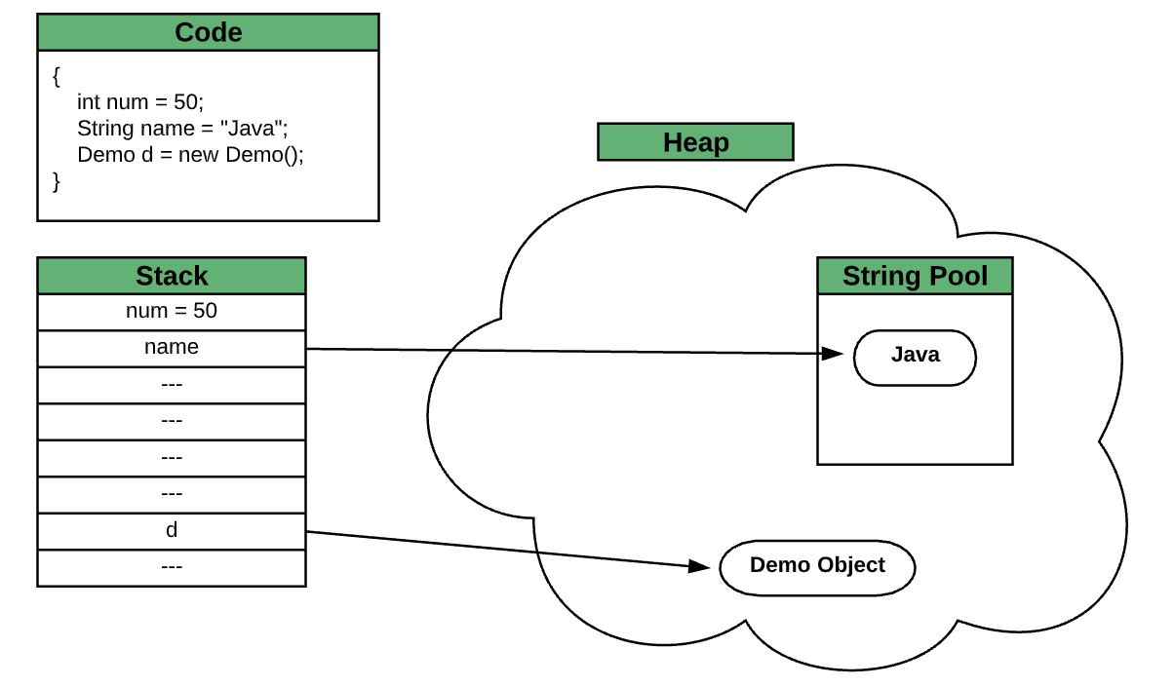
String Pool
The string pool, also known as the string literal pool, is a specific area of memory in programming languages like Java where string literals (constant strings) are stored.
The primary purpose of the string pool is to optimize memory usage and improve the efficiency of string operations. It achieves this by reusing existing string instances rather than creating new ones for the same string value.
String Literal Interning:
When you create a string using a string literal (e.g., "Hello"), the compiler checks if an identical string already exists in the string pool.
If the string is not already present in the pool, a new entry is added, and a reference to the string is returned.
If the string already exists in the pool, the compiler returns a reference to the existing instance instead of creating a new one.

Slide 20
String Pool
Immutability and Pooling:
The immutability of strings is a fundamental aspect that enables the string pool to work effectively. Since strings cannot be modified after creation, it's safe to share references to the same string instance.
Benefits of the String Pool
Memory Efficiency: By reusing string instances, the string pool helps reduce memory consumption, particularly when the same string value is used multiple times in the code.
Performance: String comparisons using reference equality (==) are much faster than comparing string contents character by character.
Explicit String Interning
In Java, you can explicitly intern a string using the String.intern() method.
This method checks if the string is already present in the pool. If not, it adds the string to the pool and returns a reference to the pooled instance.
Explicit string interning is useful when working with strings that are dynamically generated at runtime.

Slide 21
String Pool Examples
String a = "Hello"; // Stored in the string pool
String b = "Hello"; // Reference to the same instance in the pool
String c = new String("Hello"); // Creates a new instance outside the pool
String d = c.intern(); // Returns reference to the string in the pool
System.out.println(a == b); // Output: true
System.out.println(a == c); // Output: false
System.out.println(a == d); // Output: true

Slide 22
String Concatenation
Concatenating Strings with + operator
Using StringBuilder for efficient concatenation

Slide 23
String Concatenation
Concatenating Strings with the + Operator
In Java, you can concatenate strings using the + operator. When you use the + operator to concatenate strings, you create a new string that combines the contents of the original strings.
Example:
String firstName = "John";
String lastName = "Doe";
String fullName = firstName + " " + lastName;
Using StringBuilder for Efficient Concatenation
To efficiently concatenate strings in scenarios involving loops or frequent concatenations, it's recommended to use the StringBuilder class. StringBuilder is designed to create mutable strings with better performance characteristics than repeated concatenation using the + operator.
Example:
StringBuilder builder = new StringBuilder();
builder.append("Hello");
builder.append(", ");
builder.append("world!");
String result = builder.toString();

Slide 24
String Length and Operations
Finding the length of a String
Common String operations (substring, trim, toLowerCase, toUpperCase)

Slide 25
String Length
The length of a string in Java refers to the number of characters it contains. You can retrieve the length of a string using the length() method, which is a built-in method of the String class.
Example:
String text = "Hello, world!";
int length = text.length(); // length is 13

Slide 26
String Operations
Substring
The substring() method allows you to extract a portion of a string. It takes either a starting index or a starting index and an ending index.
Example:
String text = "Hello, world!";
String substring1 = text.substring(7); // "world!"
String substring2 = text.substring(0, 5); // "Hello“
Concatenation
String concatenation is done using the + operator or the concat() method.
Example:
String firstName = "John";
String lastName = "Doe";
String fullName = firstName + " " + lastName; // "John Doe"
String concatenated = firstName.concat(" ").concat(lastName); // "John Doe"

Slide 27
String Operations
Converting Case
You can convert the case of a string using toLowerCase() and toUpperCase() methods.
Example:
String text = "Hello, world!";
String lowerCase = text.toLowerCase(); // "hello, world!"
String upperCase = text.toUpperCase(); // "HELLO, WORLD!"
Trimming
The trim() method removes leading and trailing whitespace from a string.
Example:
String text = " Hello, world! ";
String trimmed = text.trim(); // "Hello, world!“
Replacing Substrings
The replace() method replaces occurrences of a substring with another string.
Example:
String text = "Hello, world!";
String replaced = text.replace("world", "universe"); // "Hello, universe!"

Slide 28
String Operations
Searching
Methods like indexOf(), lastIndexOf(), and contains() help you find occurrences of substrings.
Examples:
String text = "Hello, world!";
int index = text.indexOf("world"); // index is 7
boolean containsWorld = text.contains("world"); // true
Splitting
The split() method breaks a string into an array of substrings based on a delimiter.
Examples:
String text = "apple,banana,orange";
String[] fruits = text.split(","); // ["apple", "banana", "orange"]
Conversion to Other Types
You can convert a string to other primitive types using methods like parseInt(), parseDouble(), etc.
Examples:
String numericString = "123";
int intValue = Integer.parseInt(numericString); // 123

Slide 29
StringBuilder and StringBuffer
Introduction to StringBuilder and StringBuffer classes
Advantages of StringBuilder over String for concatenation
StringBuilder vs. StringBuffer
Choosing the right class for specific use cases

Slide 30
Introduction to StringBuffer and StringBuilder
Both StringBuilder and StringBuffer are classes in Java that are used for efficiently manipulating strings, especially when concatenating or modifying strings. They are particularly useful when you need to perform multiple modifications on a string since they avoid the performance overhead associated with repeated string concatenation using the + operator.
StringBuffer
StringBuffer is a class provided in Java to create mutable sequences of characters.
It's thread-safe, meaning multiple threads can modify a StringBuffer object simultaneously without external synchronization.
String manipulation methods in StringBuffer are synchronized, which ensures that no two threads interfere with each other's actions.
StringBuilder
StringBuilder is also a class that creates mutable sequences of characters, similar to StringBuffer.
It is not thread-safe, which means it's suitable for single-threaded scenarios where synchronization is not a concern.
StringBuilder methods are not synchronized, making them faster in single-threaded environments.

Slide 31
Advantages of StringBuilder over String for concatenation
When concatenating strings, especially within loops or when multiple concatenations are involved, using StringBuilder provides several advantages over using the + operator or String concatenation:
Efficiency:
StringBuilder is more memory-efficient compared to String concatenation, which creates new string instances every time concatenation occurs.
StringBuilder modifies the existing buffer instead of creating intermediate string objects, resulting in better performance and memory usage.
Performance:
Repeated string concatenation using the + operator has a time complexity of O(n^2) due to repeated copying of characters. This becomes inefficient for large strings or many concatenations.
StringBuilder has a constant time complexity (O(n)) for appending characters, making it significantly faster for large strings or many concatenations.
Reduced Garbage Collection:
StringBuilder reduces the number of temporary string objects created during concatenation, resulting in less frequent garbage collection and improved memory management.
Convenient API:
StringBuilder provides a convenient set of methods for appending, inserting, deleting, and modifying characters and substrings within a buffer.

Slide 32
StringBuffer vs StringBuilder
StringBuffer Class | StringBuilder Class
StringBuffer is present in Java 1.0. | StringBuilder was introduced in Java 5.
StringBuffer is synchronized. This means that multiple threads cannot call the methods of StringBuffer simultaneously. | StringBuilder is asynchronized. This means that multiple threads can call the methods of StringBuilder simultaneously.
Due to synchronization, StringBuffer is called a thread safe class. | Due to its asynchronous nature, StringBuilder is not a thread safe class.
Due to synchronization, StringBuffer is lot slower than StringBuilder. | Since there is no preliminary check for multiple threads, StringBuilder is a lot faster than StringBuffer.

Slide 33
Interview Questions

Slide 34
Arrays Interview Questions
What is an array? How does it help in storing multiple values?
How do you access a specific element in an array? Why is indexing important?
Can you explain zero-based indexing in arrays? Why do most programming languages use it?
What's the difference between a static array and a dynamic array?
How can you find the length or size of an array?
Explain the process of initializing an array with values.
What is a "multidimensional array"? Can you provide an example?
How can you add elements to the end of an array? Is it different for static and dynamic arrays?

Slide 35
Arrays Interview Questions
What's the difference between searching and sorting in arrays?
How can you find the maximum value in an array? What about the minimum value?
Explain the concept of a "for loop" and how it can be used to iterate through an array.
What does it mean to "traverse" an array? Why is this important?
How can you remove an element from an array? Is it straightforward?
Can you describe how you would swap two elements in an array?
What is a "subarray"? How can you find the sum of elements in a subarray?
Explain why arrays are a fundamental concept in computer programming.

Slide 36
String Interview Questions
Write a Java function to check if a given string is a palindrome.
How can you find the length of a string in Java?
Explain the split() method for strings in Java.
How can you replace a specific character or substring in a string?
Describe how you can format strings using the String.format() method.
Explain the purpose of escape characters in strings. Provide examples.
How do you convert a numeric value to a string in Java?
What are the differences between using the + operator and StringBuilder for string concatenation?
How can you check if a string starts with or ends with a specific substring?
What is the charAt() method in Java, and how is it used?
Write a Java program to count the occurrences of a specific word in a string.

Slide 37
String Interview Questions
What is a string in Java and how is it different from other data types?
Explain the concept of string immutability in Java.
How can you compare two strings for equality in Java?
Describe the differences between == and .equals() when comparing strings.
What is string interning in Java?
How can you concatenate strings efficiently in Java?
Explain the purpose of the StringBuilder class in Java.
What is the difference between StringBuilder and StringBuffer classes?
How can you convert a string to lowercase and uppercase in Java?
Explain the significance of the substring() method in Java.
What is the importance of the trim() method for strings?

Slide 38
Assignments

Slide 39
Array Assignments
Assignment 1: Array Basics
Write a program that initializes an array with your favorite foods and prints them out.
Create an array of integers. Calculate and print the sum of all the elements.
Write a program to find the largest and smallest numbers in an array of integers.
Implement a function that takes an array of numbers as input and returns the average.
Assignment 2: Array Manipulation
Create an array of names. Sort the names in alphabetical order and print the sorted list.
Given an array of integers, write a program to find the second-largest number.
Write a program to reverse the elements of an array.
Implement a function to count the occurrences of a specific number in an array.
Assignment 3: Multidimensional Arrays
Write code to initialize a 2D array and print its elements row by row.
Write a program to find the sum of the diagonal elements in a square 2D array.
Write a function to find the maximum element in a 2D array.

Slide 40
String Assignments
Reverse a String: Write a function to reverse a given string.
Check Palindrome: Write a function to check if a given string is a palindrome.
Anagram Check: Write a function to determine if two strings are anagrams of each other.
String Length: Write a function to find the length of a given string.
Concatenate Strings: Write a function to concatenate two strings.
String to Integer Conversion: Write a function to convert a string containing a number to an integer.
Count Vowels: Write a function to count the number of vowels in a string.
Count Substrings: Write a function to count occurrences of a specific substring in a given string.
Uppercase to Lowercase: Write a function to convert uppercase characters in a string to lowercase.
Remove Spaces: Write a function to remove all spaces from a given string.

Slide 41
String Assignments
Find First Non-Repeated Character: Write a function to find the first non-repeated character in a string.
Palindrome Check : Write a function to check if a string is a palindrome while ignoring spaces and non-alphanumeric characters.
String Rotation: Write a function to determine if one string is a rotation of another string.
Reverse Words in a String: Write a function to reverse the order of words in a given string.
Count Words: Write a function to count the number of words in a sentence.
Remove Duplicates: Write a function to remove duplicate characters from a string.
Check Permutation: Write a function to check if one string is a permutation of another string.
String Truncation: Write a function to truncate a string to a specified length.
Replace Spaces: Write a function to replace spaces in a string with a specified character.

Slide 42
Q&A

